Slide 1
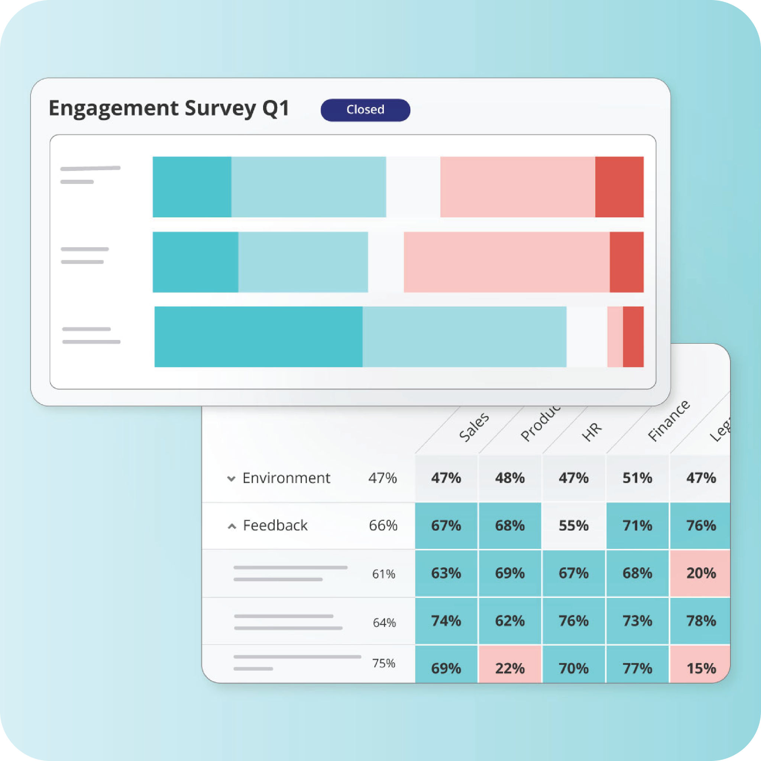
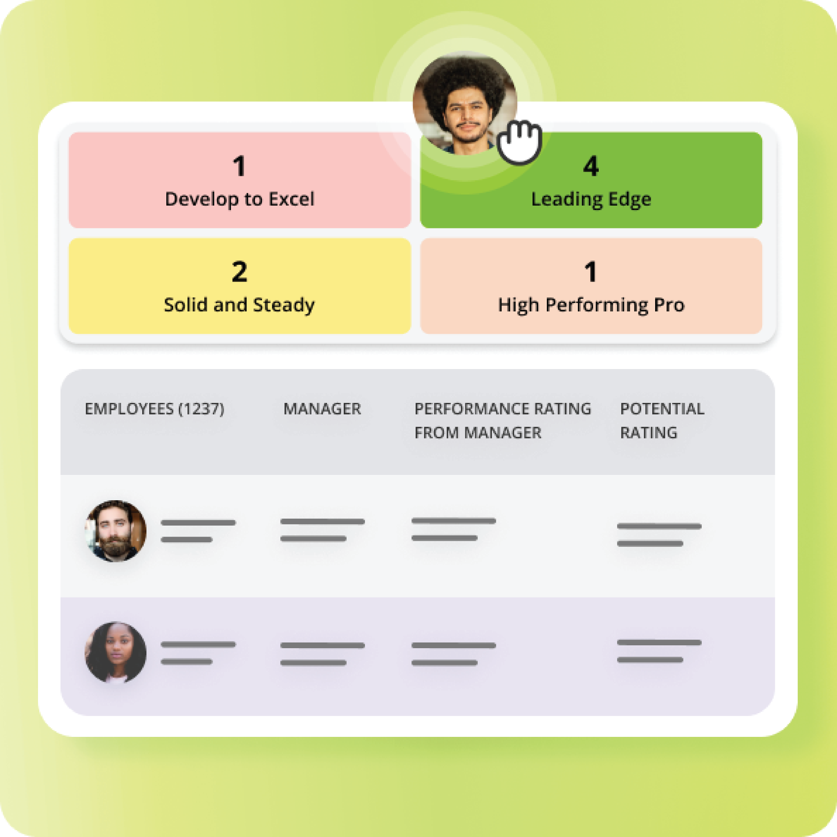
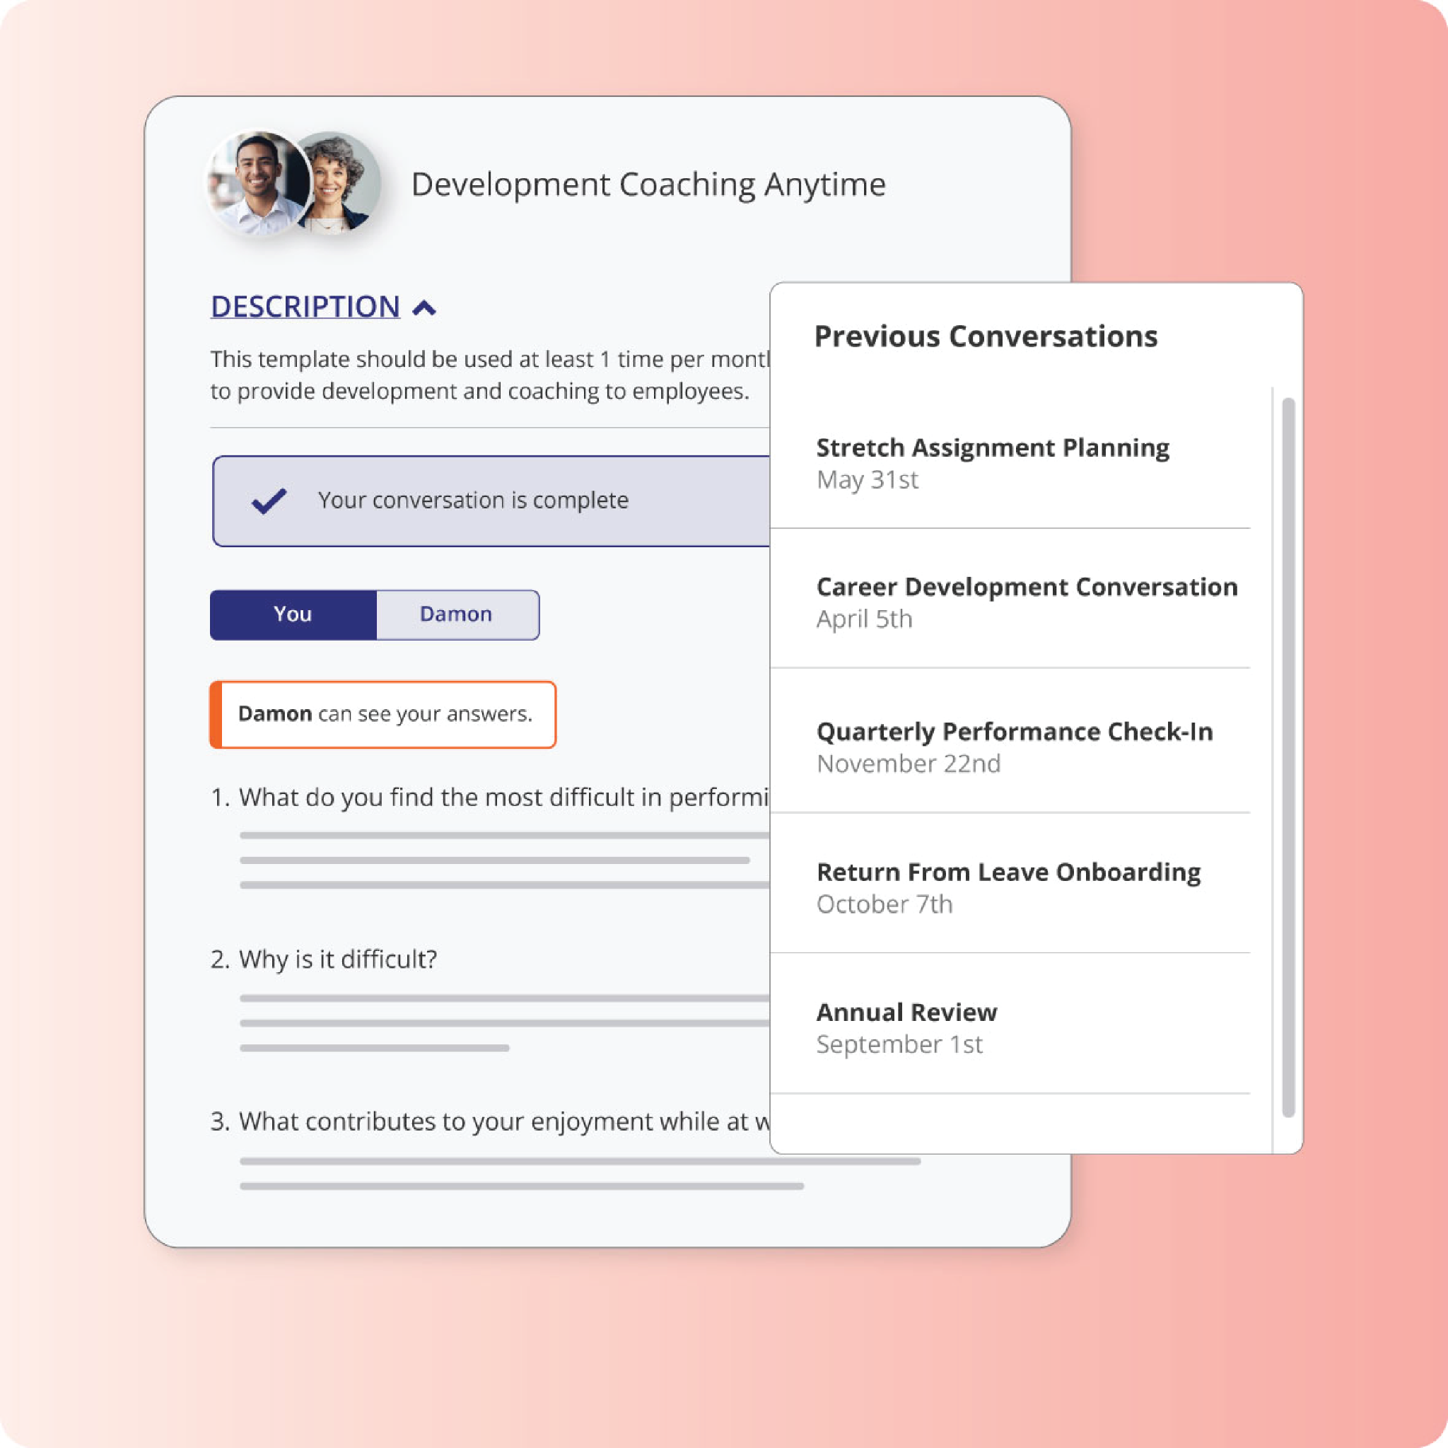

The New NextGen Experience
Quick Guide to What’s New in Our Platform

Slide 2
The New Betterworks NextGen Experience
Our program will be upgrading to the new Betterworks NextGen user interface. This change is part of improving how we align goals, support ongoing conversations, develop through feedback, and keep teams connected to the work that matters most.
This quick guide explains what’s changing, what’s staying the same, and how we will support everyone through the transition.
What’s New & What’s Changing
You’ll notice a refreshed, more intuitive experience designed to make day-to-day performance activities easier.
Modern, simplified layout
Cleaner design
Updated navigation
Improved clarity
Streamlined workflows
Improved goal creation functionality and alignment
Updated and new AI assists and summaries
Clearer focus on your performance and talent profile
Improved dashboards
Updated personal and manager views
Clearer progress visuals
Easier access to upcoming To Dos and actions
Better accessibility
More intuitive mobile experience
Improved responsiveness
Enhanced support for divers users
Insert visual for your program
Notes:
Slide Instructions:
To swap out the image with a new screenshot, right click and select “Replace image”. Add your new image in and the settings should be automatically applied.
Helpful tip: Double-click your image to adjust it within the frame.

Slide 3
The New Betterworks NextGen Experience
What’s NOT Changing
This upgrade does not change our performance program or expectations.
Our performance cycles, timelines, and processes
Templates, frameworks, and program requirements
Team and manager responsibilities
Your goals, conversations, and historical data
Everything you’ve created or completed in Betterworks remains exactly the same.
Insert visual for your program
How We’ll Support You
During the transition, our internal team will provide:
Updated walkthrough guides
Employee and Manager Quick Start guides
Training materials and short demos
Clear communication before and after launch
Support channels for any questions
Timeline at a Glance
Our transition will follow a structured rollout:
Test environment upgrade & validation
Content updates and training preparation
Training for employees and managers
Production upgrade
Post-launch reinforcement and support
You’ll receive additional details and resources as we move through each stage.
Please reach out to your manager or [name and email] for support during the transition.
Notes:
Slide Instructions:
To swap out the image with a new screenshot, right click and select “Replace image”. Add your new image in and the settings should be automatically applied.
Helpful tip: Double-click your image to adjust it within the frame.

