Slide 1
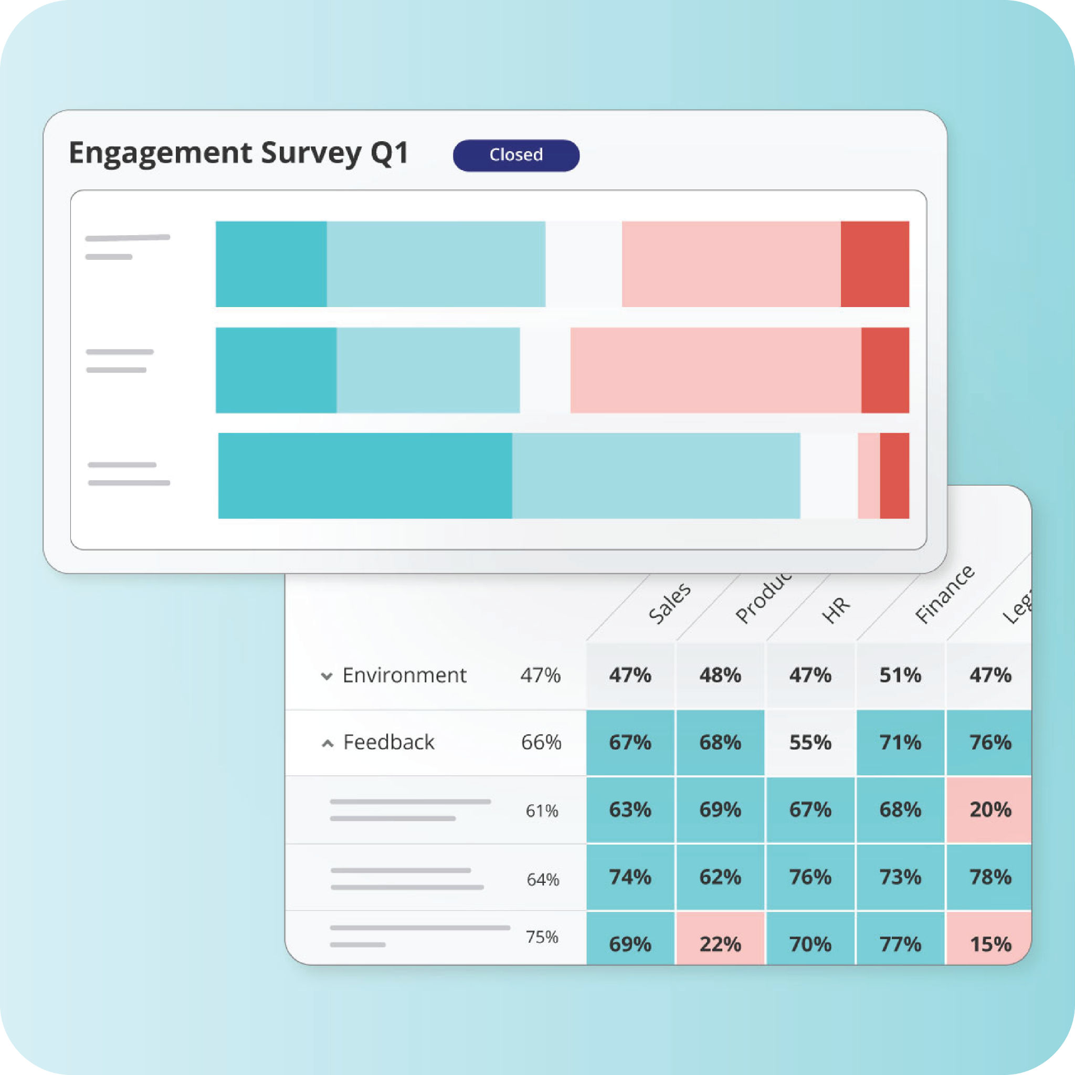
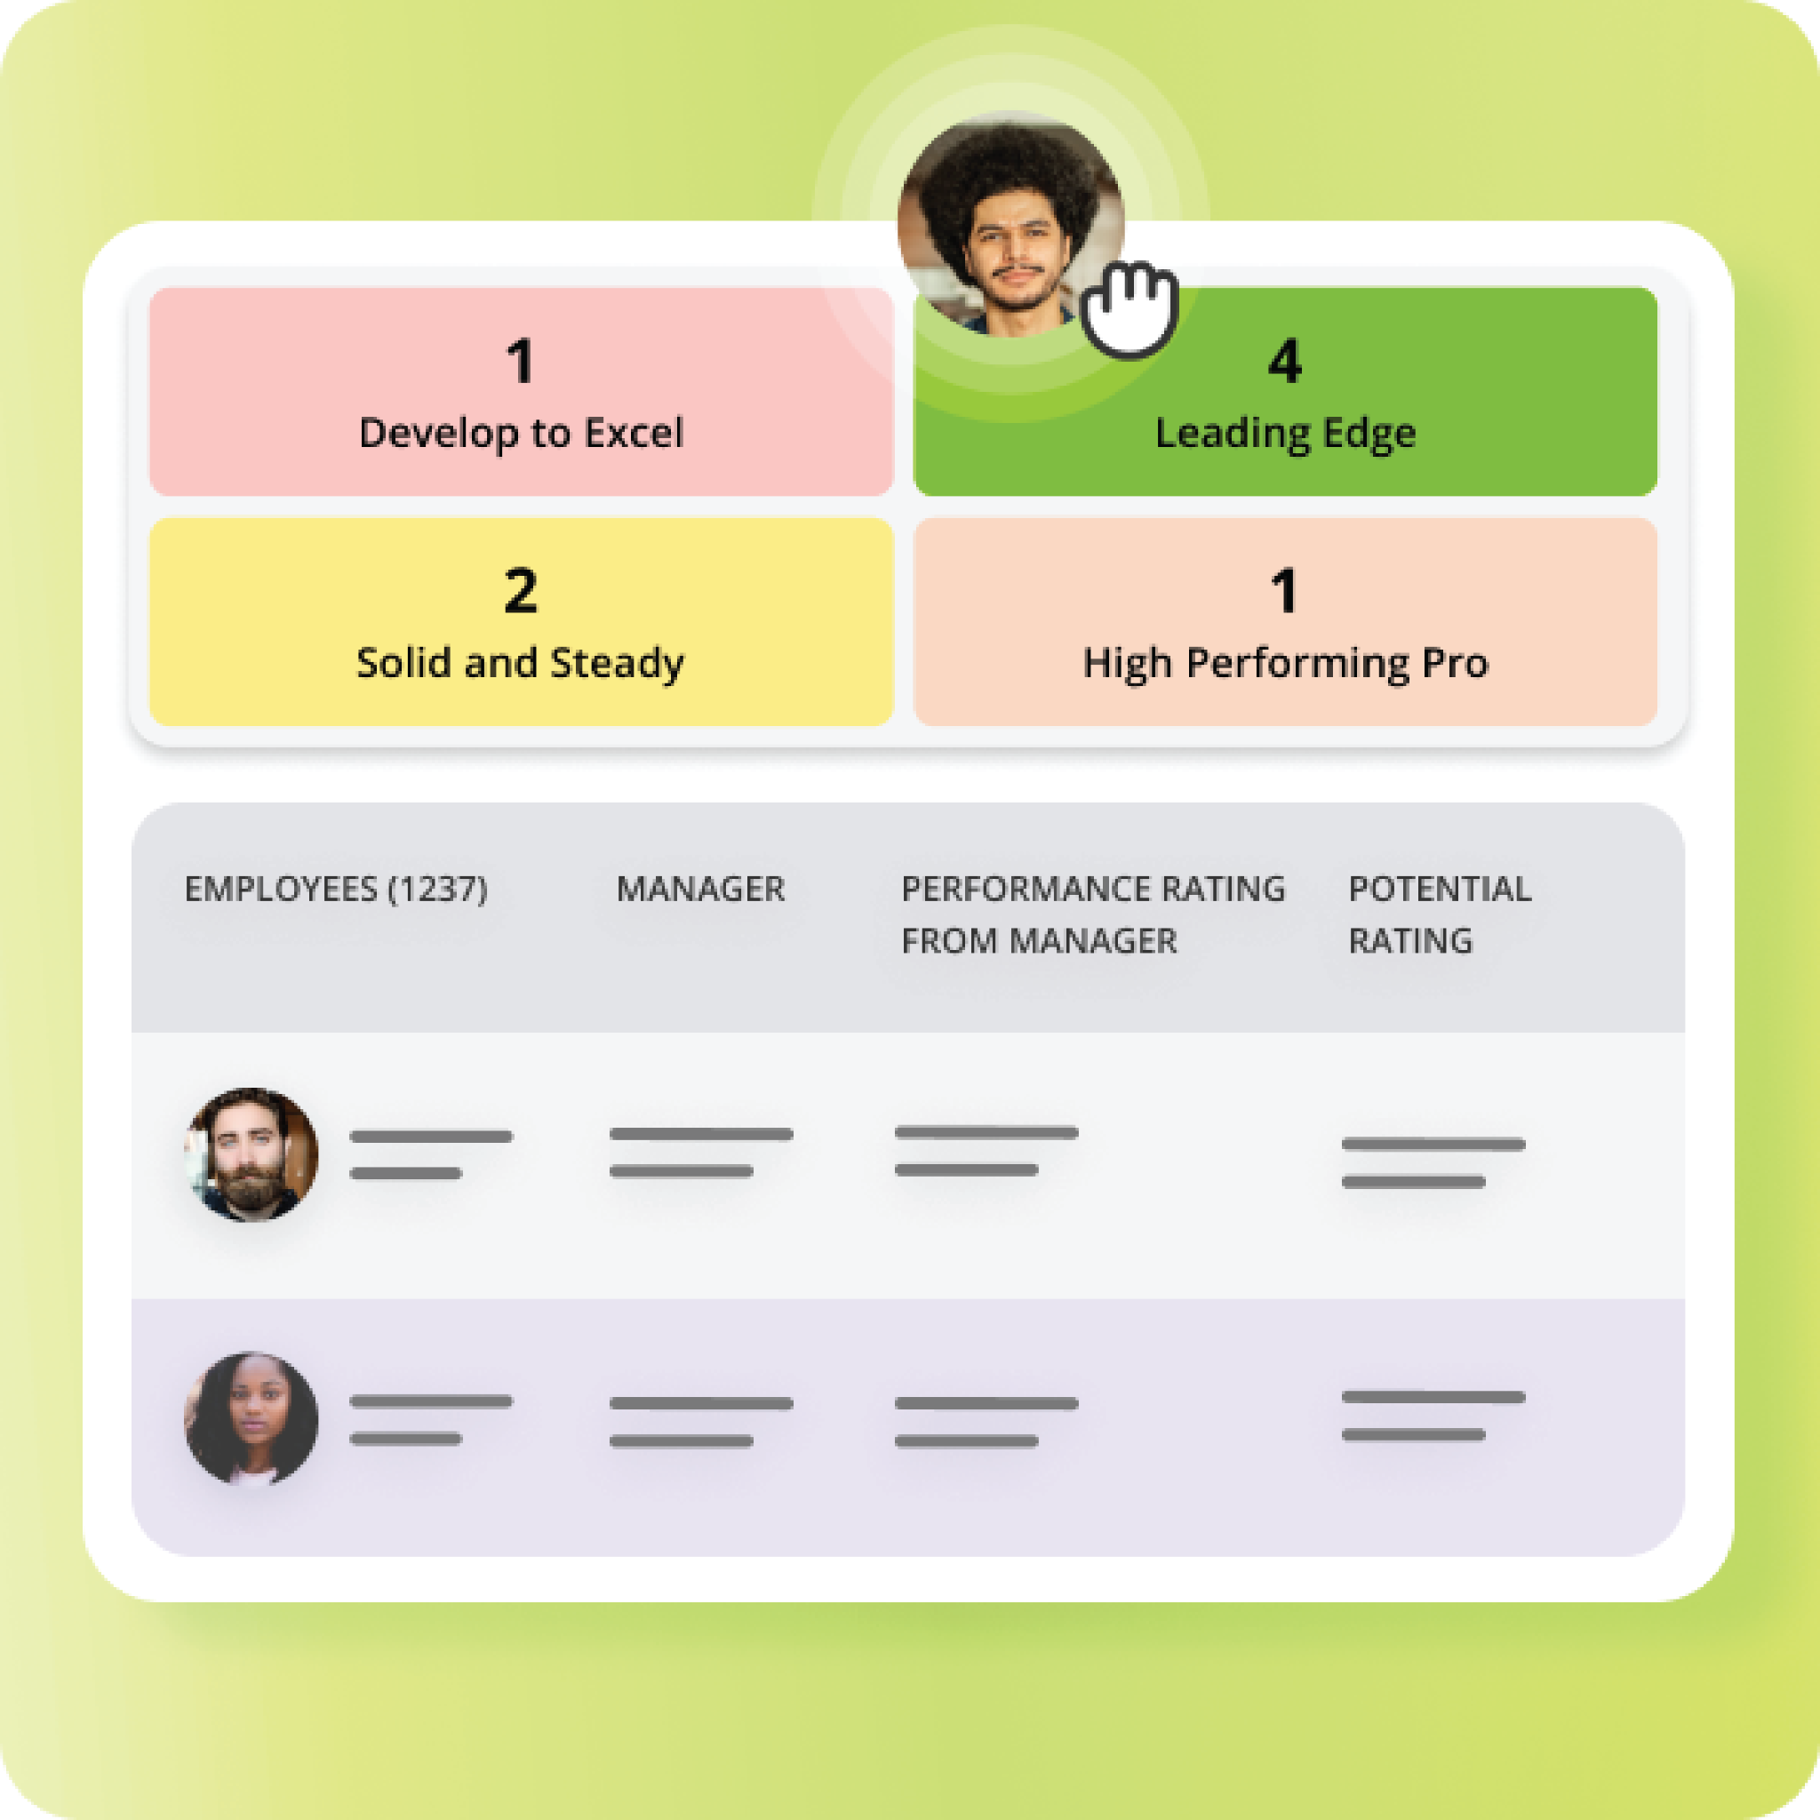
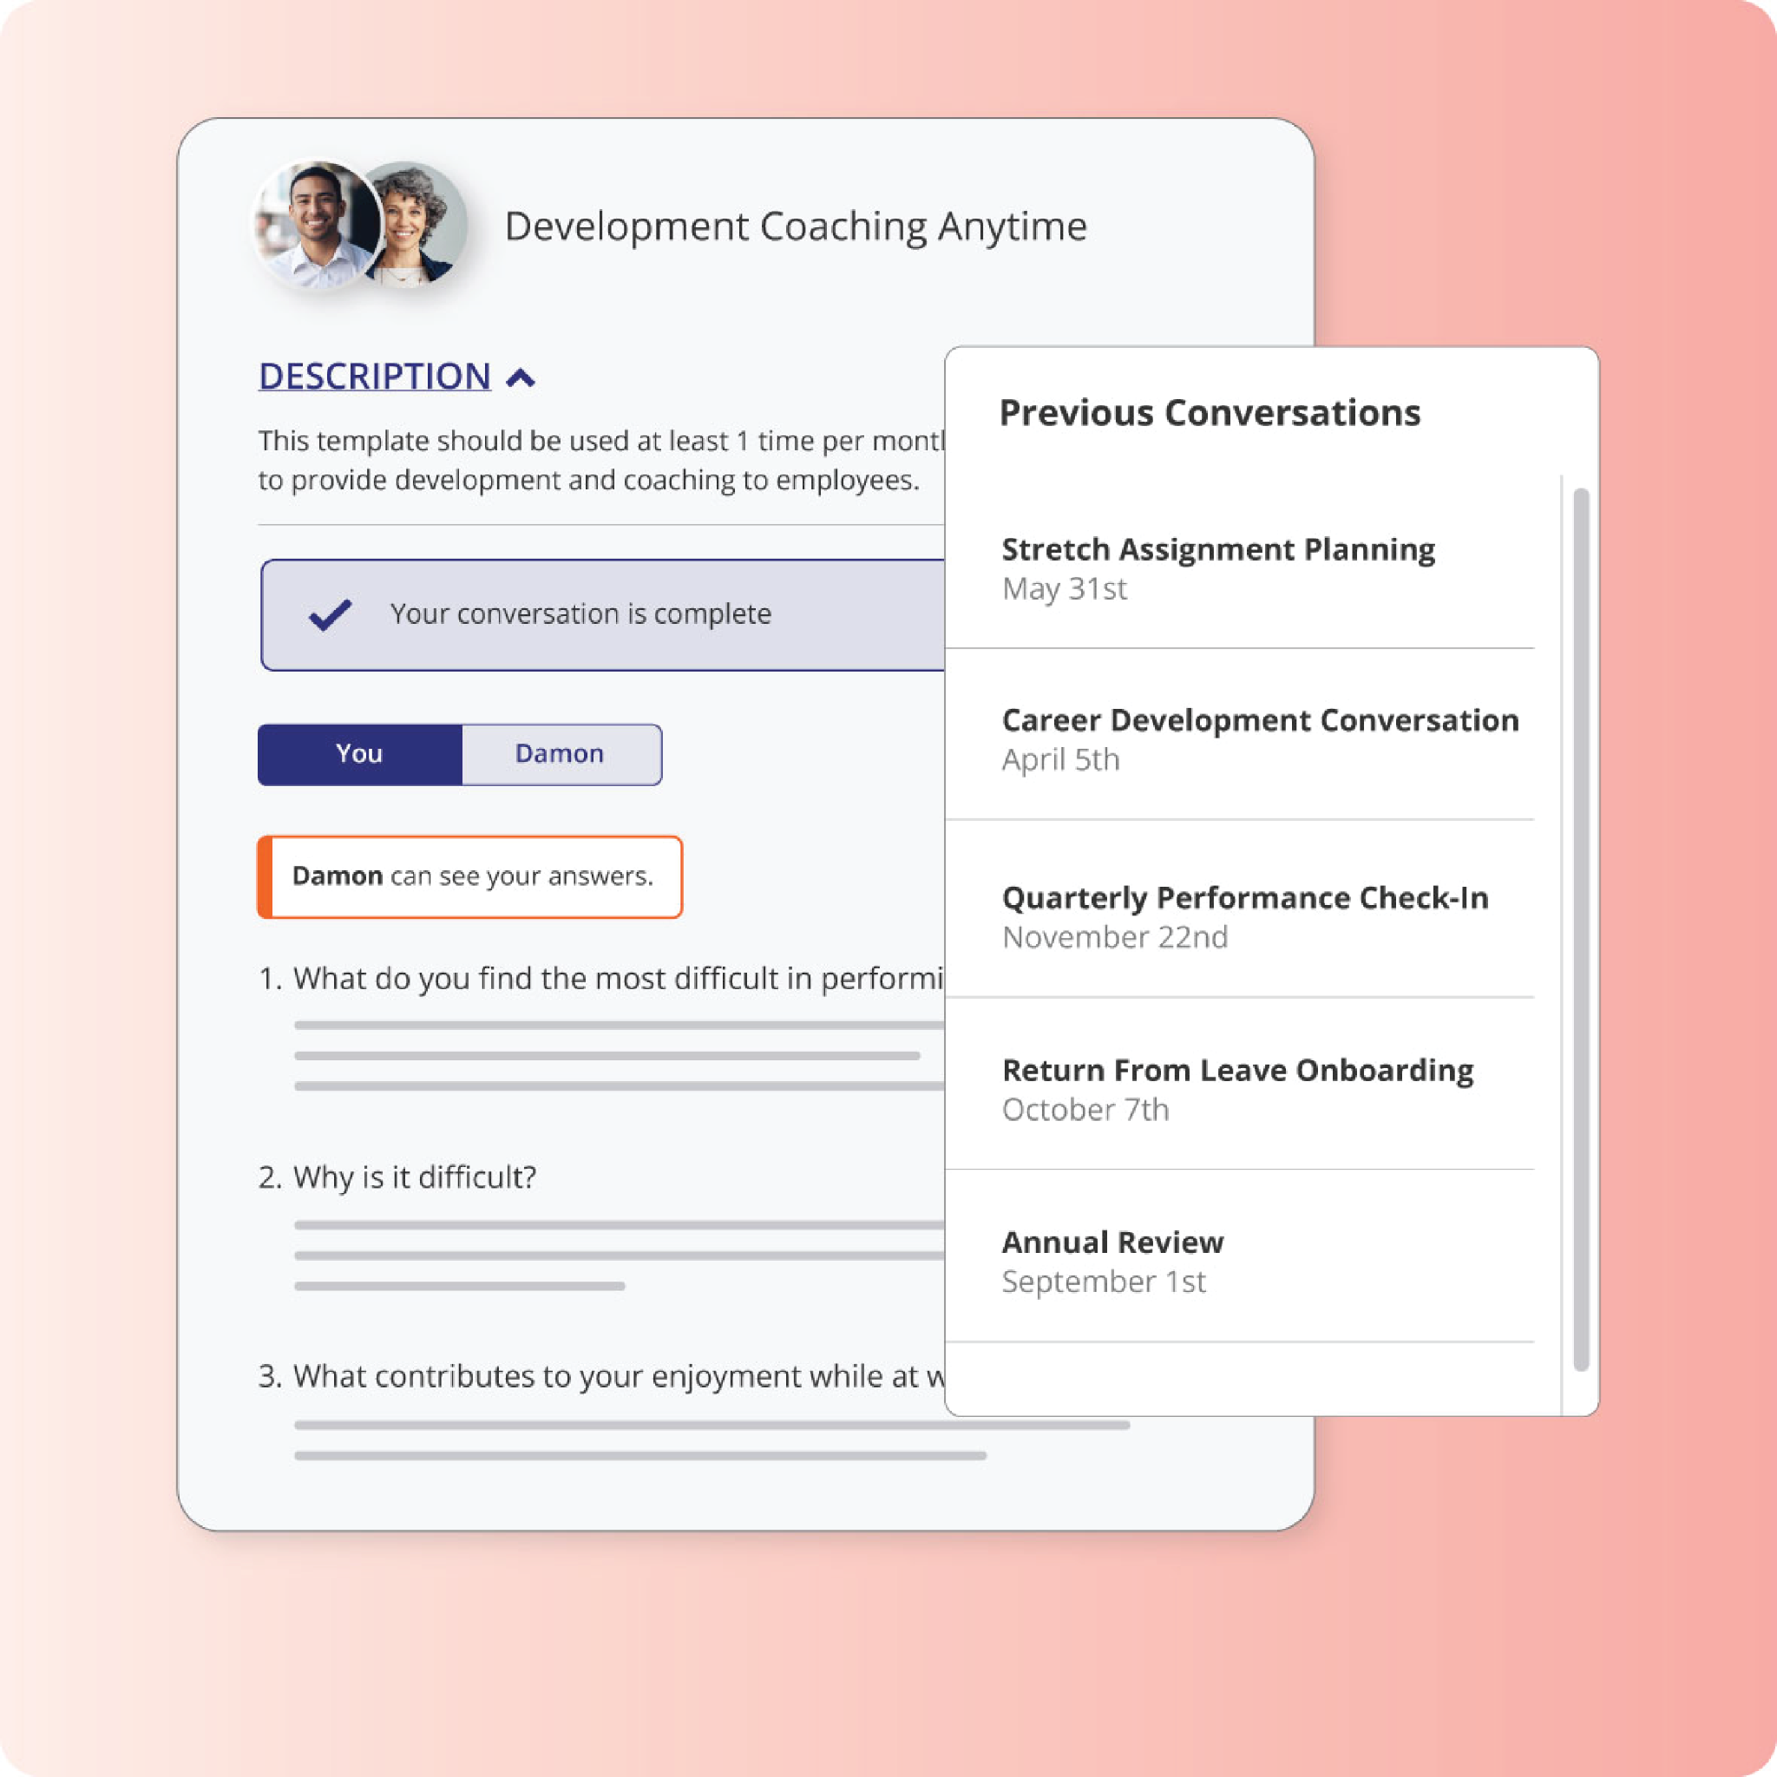

Manager Quick Start Guide
What’s new for Managers in Betterworks NextGen

Slide 2
Manager Quick Start Guide
What’s New for Managers
We’ve upgraded our Betterworks experience to make it easier for you to support your team through goal-setting, ongoing check-ins, and everyday performance conversations.
You’ll notice:
A cleaner, more intuitive layout
Easier navigation between your goals and your team’s goals
Clearer dashboards to track to-dos, progress and follow ups
Streamlined workflows for conversations, feedback, and 1:1s
New and improved AI writing assistants and AI summaries
What’s NOT changing: Our performance program, expectations, cycles, and goals remain the same.
Your role in the transition:
Reassuring your team that the update is about usability, not new requirements
Encouraging employees to explore the new layout
Reinforcing regular goal updates and check-ins
Pointing your team to available resources when questions arise
Where to begin:
Review your team dashboard: Get a quick view of goal progress, upcoming conversations, and key actions.
Review your team’s goals: Familiarize yourself with the updated goal layout and progress indicators.
Check upcoming check-ins or conversations: Review templates, add notes, and prepare as usual.
Give feedback or recognition: Use the updated flow to reinforce progress or celebrate wins.
Notes:
Slide Instructions:
To swap out the image with a new screenshot, right click and select “Replace image”. Add your new image in and the settings should be automatically applied.
Helpful tip: Double-click your image to adjust it within the frame.

Slide 3
Manager Quick Start Guide
Tips for supporting your team:
Normalize exploration: “Take a few minutes to click around and check out what’s new.”
Keep expectations consistent: focus on the same goals and timelines.
Share quick tips with your team as you discover them.
Encourage employees to ask questions and surface issues early.
Resources available to you:
Employee Quick Guide
Updated walkthrough guides
Updated training materials (live or recorded, if applicable)
Internal HR / Program team support
If something doesn’t look right or you need help, please reach out to [Internal Program or HR Contact].
One last thing:
The new experience is designed to make your job as a manager easier with clearer priorities, better visibility, and smoother conversations. Give yourself a few minutes to explore, and encourage your team to do the same.
Notes:
Slide Instructions:
To swap out the image with a new screenshot, right click and select “Replace image”. Add your new image in and the settings should be automatically applied.
Helpful tip: Double-click your image to adjust it within the frame.

