Slide 1
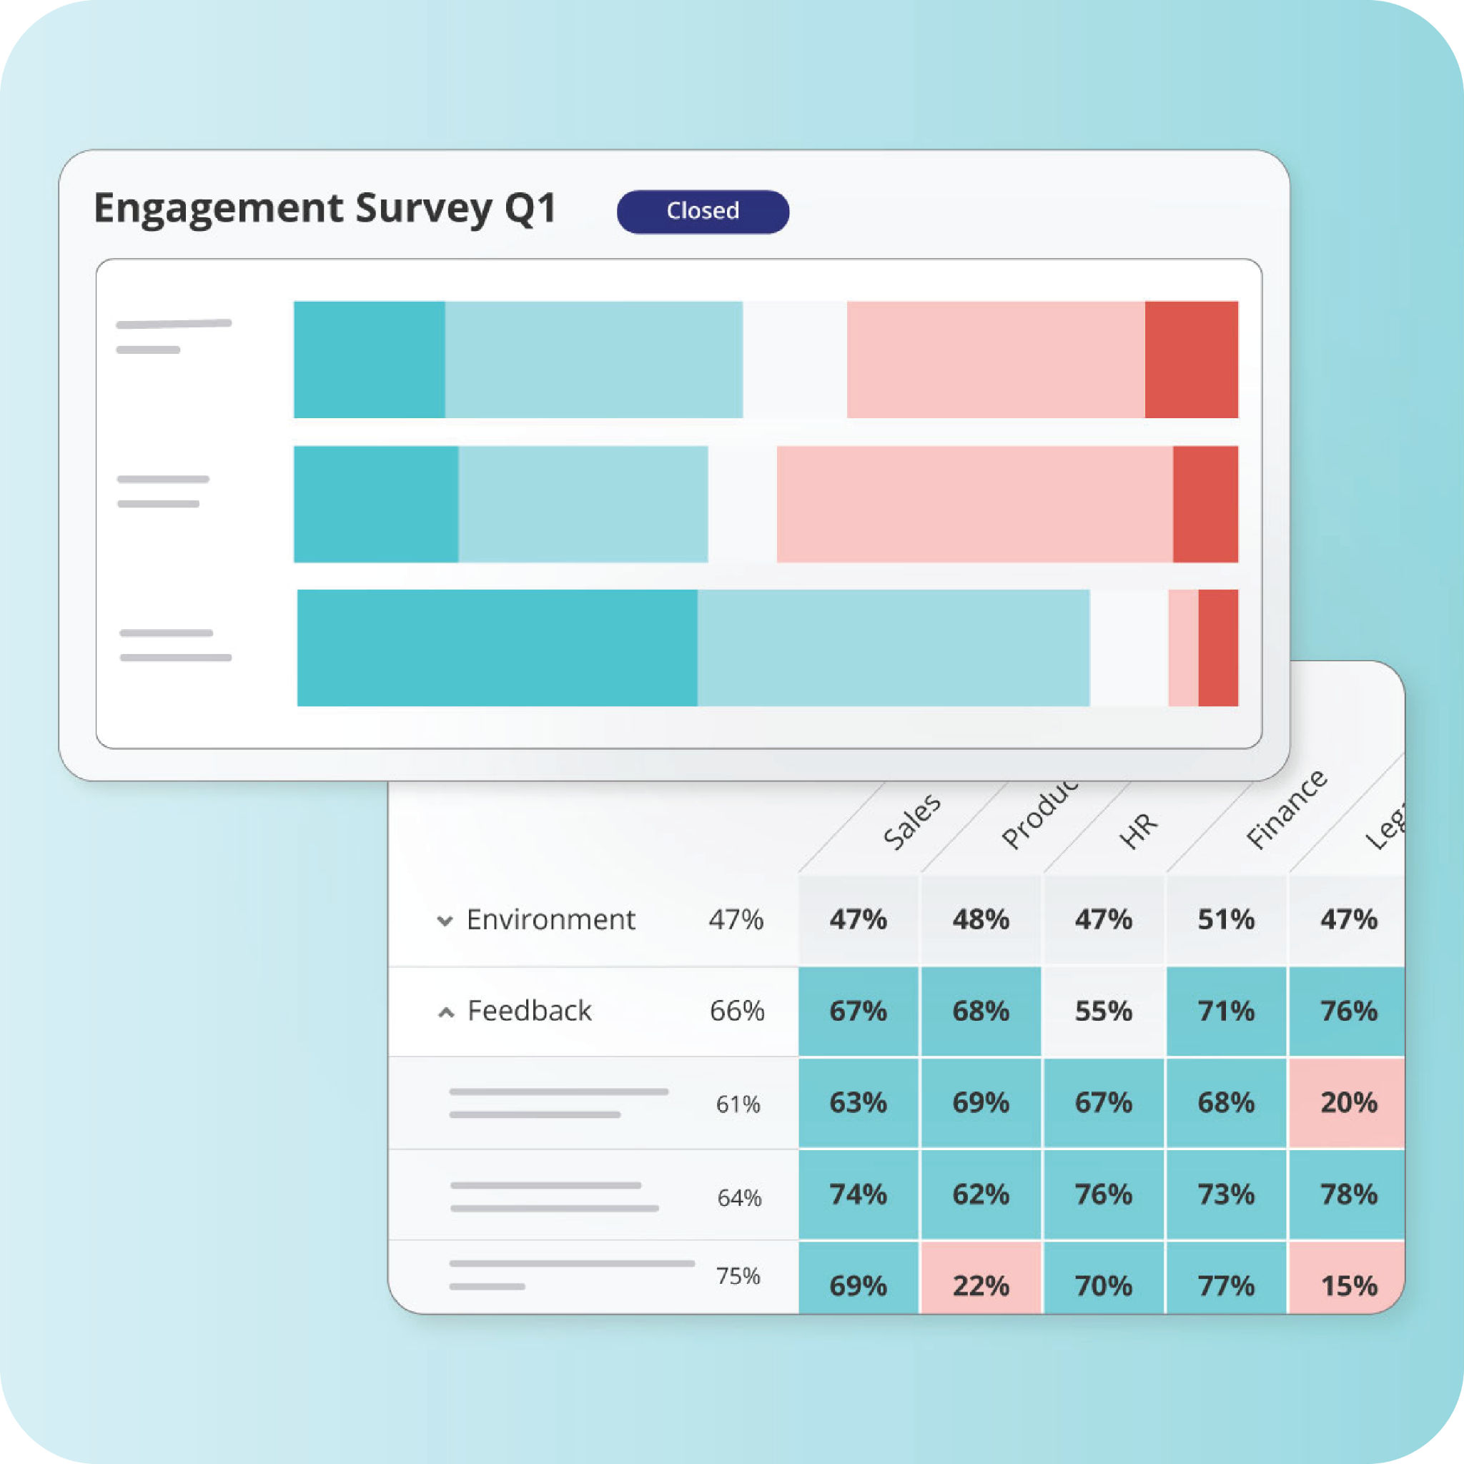
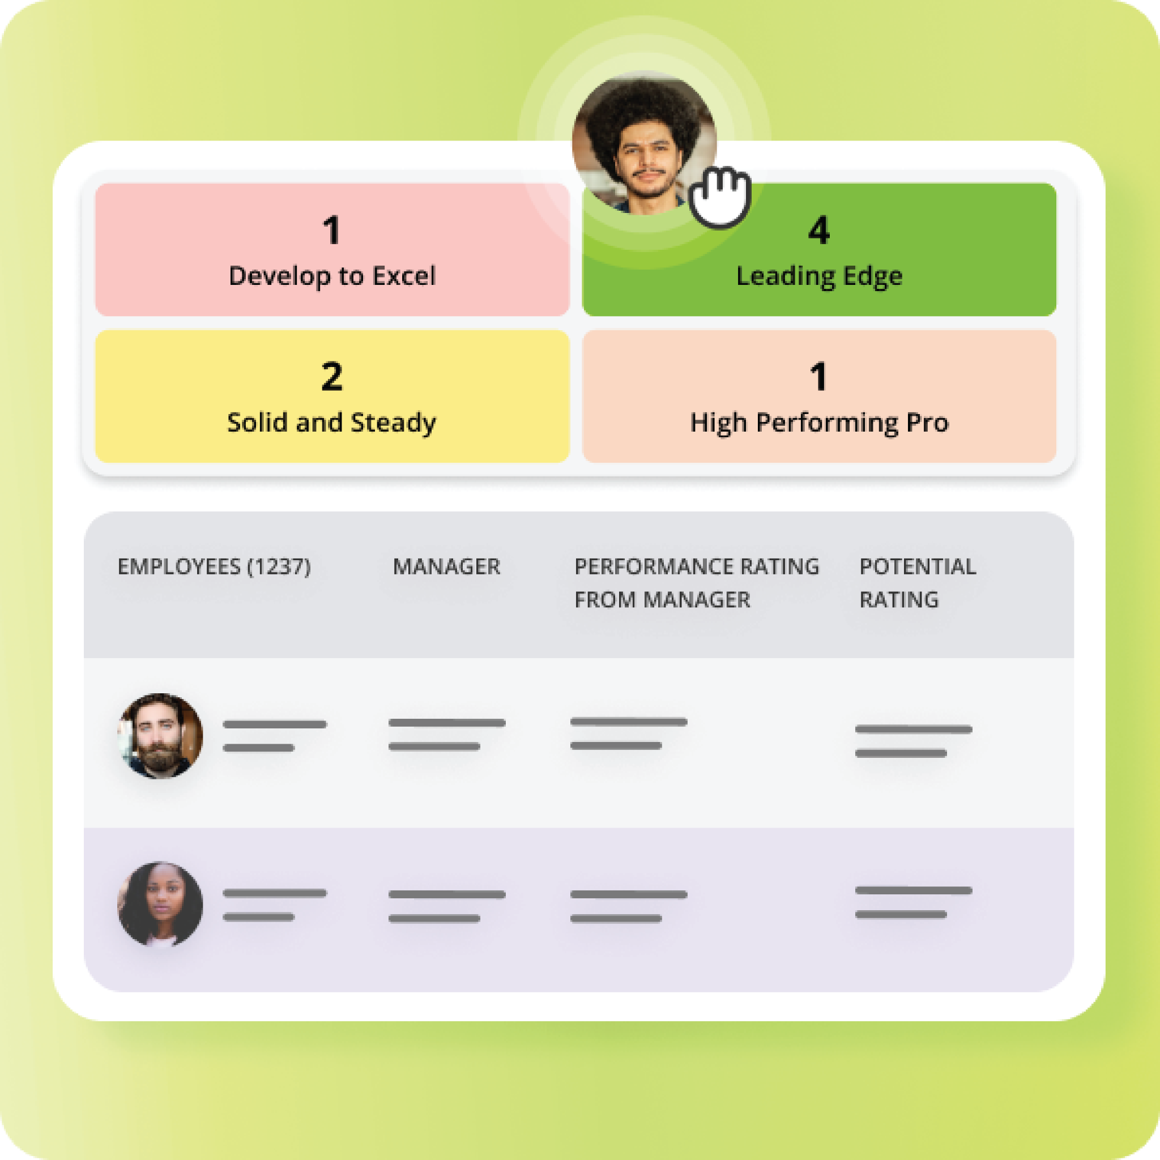
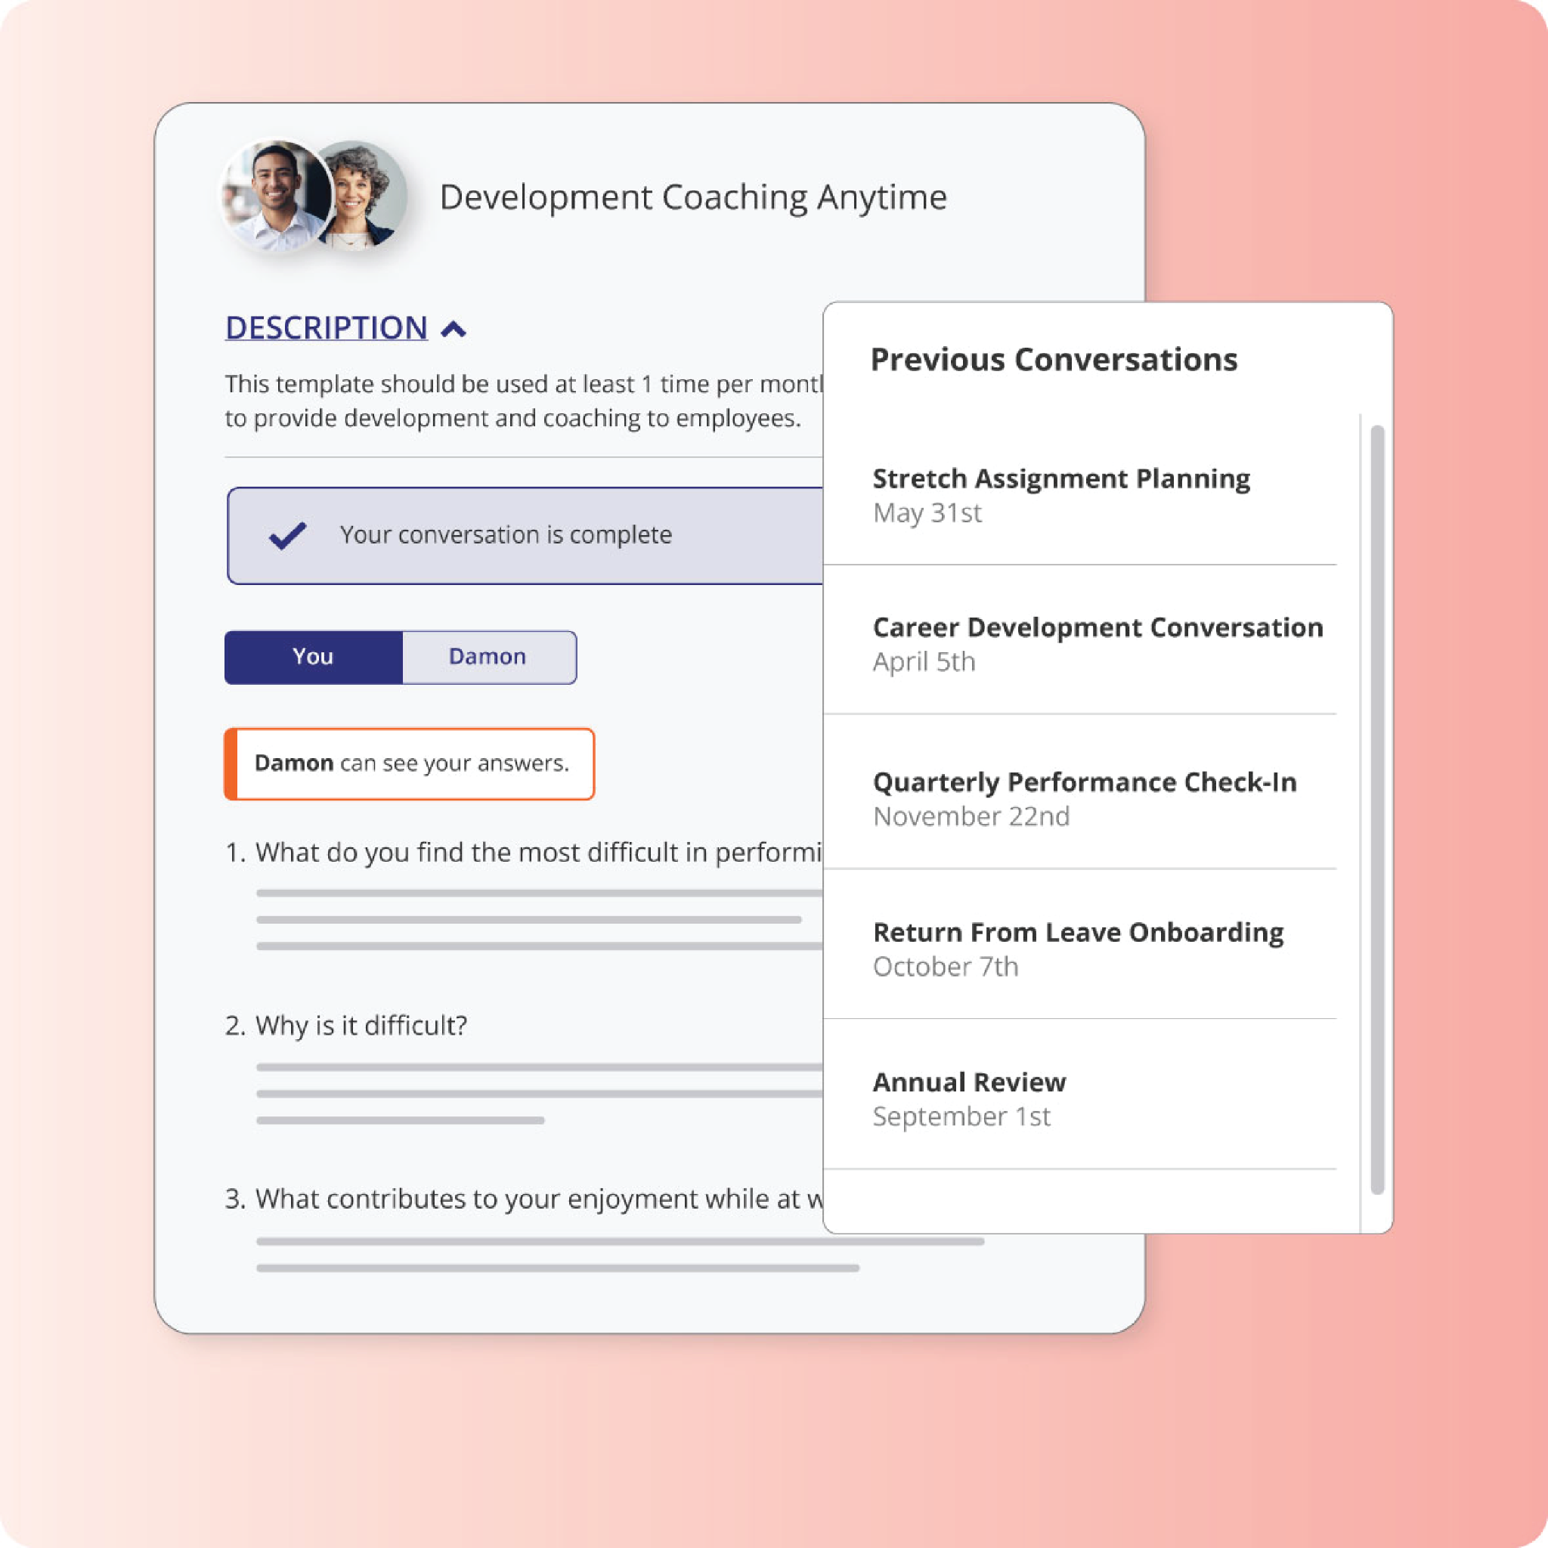

Employee Quick Start Guide
What’s new for Employees in Betterworks NextGen

Slide 2
Employee Quick Start Guide
What’s New for Employees
We’ve updated the Betterworks experience to make it simpler and easier to use. You’ll notice a cleaner layout, clearer navigation, and easier ways to access your goals, conversations, and feedback.
This update is about improving the experience, not changing expectations.
What hasn’t changed:
Your goals and progress
Your conversations and feedback history
Your performance cycles and timelines
What’s expected of you
Everything you’ve already created in Betterworks is still there.
How to get started:
Look at your homepage dashboard: You’ll see your goals, upcoming check-ins, and recent activity in one place.
Open your goals: Review your progress and add an update if needed.
Check upcoming conversations or 1-1s: Add notes or prepare as usual.
Give feedback or recognition: Use the updated flow to give or request feedback.
Helpful Tips:
Take a few minutes to click around and get familiar with the layout
Don’t worry about “breaking” anything, this is just a new interface
Ask questions or surface issues early if something feels unclear
Notes:
Slide Instructions:
To swap out the image with a new screenshot, right click and select “Replace image”. Add your new image in and the settings should be automatically applied.
Helpful tip: Double-click your image to adjust it within the frame.

Slide 3
Employee Quick Start Guide
Where to get help:
If you have questions or something doesn’t look right:
Review the quick guides and walkthroughs
Talk with your manager
Contact [Internal Program or HR Team]
Support is available, and we’re here to help make this transition smooth.
One last thing:
The updated Betterworks experience is designed to make staying aligned, prepared, and focused easier. Give it a few minutes, explore a few new things, and you’ll be on your way.
Notes:
Slide Instructions:
To swap out the image with a new screenshot, right click and select “Replace image”. Add your new image in and the settings should be automatically applied.
Helpful tip: Double-click your image to adjust it within the frame.

